Slide 1
Anti-Bullying Alliance
Notes:
The speech will cover:
the national picture of cyberbullying in England,
what are the key issues for young people,
how can schools support young people to address cyerbullying
what resources / tools are available for schools and young people
the picture for cyberbullying and disabled young people and those with SEN
There will be a question put to you at the end of the presentation and a chance for questions.

Slide 2
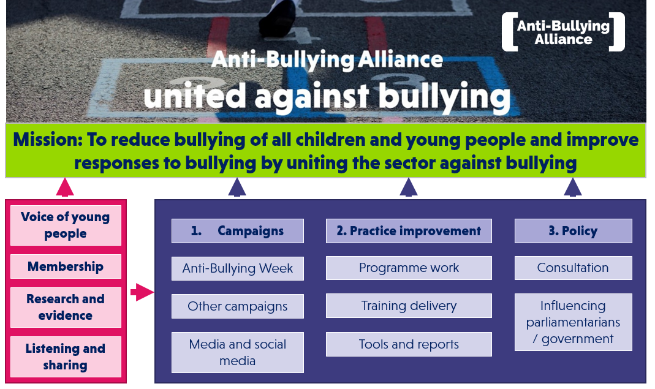

Slide 3
History
Set up in 2002 by NSPCC and NCB
Hosted by NCB
Bringing the anti-bullying sector together
Funded by DCSF/DfES to hold Anti-Bullying Week and regional reps
Notes:
The same is true of the impact of online bullying and the signs you should look for.
Bullying can hugely impact on self esteem and confidence. Many disabled young people develop individualised and internalised responses to bullying as if their experiences of bullying were their own fault or responsibility. Linked to self exclusion where young people felt that they should remove themselves from, or avoid certain situations adapting their own behaviours and use of space rather than believing others had a role in helping and supporting them.
They also call for more effective programmes to prevent bullying in schools. Bullying victimisation and risk of self harm in early adolescence: longitudinal cohort study Helen L Fisher and others. BMJ Online, 26 April 2012 )

Slide 4
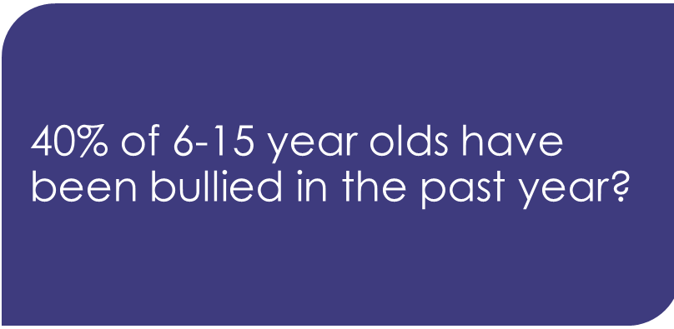

True or false?
40%
Notes:
True
The statistics differ from study to study but the general picture is that roughly 30-40% of children have been bullied in the past year. A survey of 10,000 12-20 year-olds carried out by Ditch the Label this year, actually found that 52% of those surveyed reported being bullied in the past 12 months.
The answer will not appear in the participants’ pack
The answer is animated and will float in on a click.

Slide 5
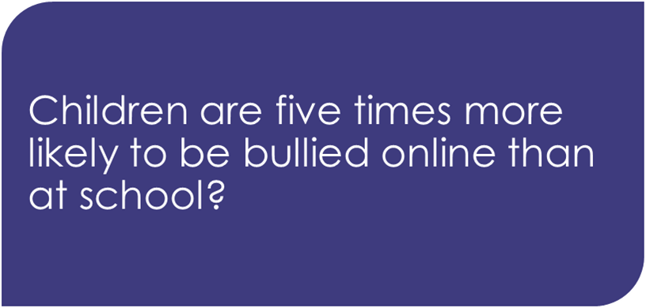



True or false?
Notes:
False - Children are five times more likely to be bullied at school than at online. It found that 87% of bullied children have faced it in school. Intermediate media and Anti-Bullying Alliance 2015
https://www.primarytimes.net/news/2015/02/children-almost-five-times-more-likely-to-be-bullied-in-school-than-online-finds-immediate-youth-children-s-study-
This slide will not appear in the participants’ pack
The answer is animated and will float in on a click

Slide 6

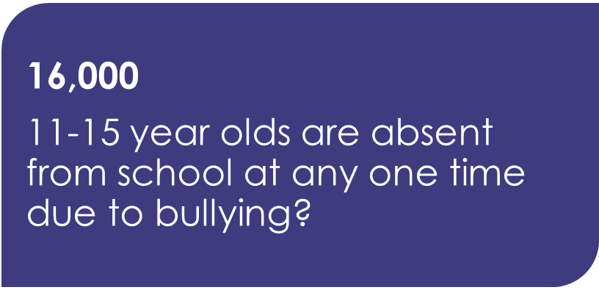

True or false?
Notes:
True - does your school record bullying as a reason for absence?
Natcen and Red Balloon 2011
http://www.natcen.ac.uk/media/22457/estimating-prevalence-young-people.pdf
This slide will not appear in the participants’ pack
The answer is animated and will float in on a click

Slide 7

The impact of bullying
Notes:
We will take a look at Cyberbullying as a distinct phenomenon as it an area of concern to many schools and has its own particular challenges

Slide 8
Short term impact
CYP who have experienced bullying are more likely to:
Face barriers to learning
Miss school
Be excluded
Retaliate
Place strain on families/carers
Have impaired wellbeing
Self harm and experience depression
Notes:
The impact of bullying is severe
It should be seen as a barrier to learning and potentially a safeguarding issue.
The arrows illustrate that with persistent bullying research shows that levels of poor outcomes and harm increase significantly.
There is no way of knowing how an individual child/young person is going to respond to different levels of bullying but longitudinal studies published in the last couple of years (Warwick Cohort and Institute of Education) are very clear that some or all of the above are likely to happen.
Services, in particular CAMHS (Child and Adolescent Mental Health Services), tend to have long waiting lists and are not always easy to access. Funding constrictions on Local Authority services may mean that they are devising new ways of working within their school support teams.
When talking about self-harm and depression if suicide is raised by participants we suggest that you say that these cases are very rare but we do need to be very mindful of the extreme vulnerability of children and young people experiencing bullying. It is important that you NEVER talk about suicide if you have children and young people in the audience.
For information about the references to these statistics you can see our ‘Focus On’ bullying guide on the ABA website.

Slide 9
The long term impact of bullying
Adults who have experienced bullying are more likely to:
Earn less money
Achieve fewer academic qualifications
Not be in a stable relationship
Be obese
Experience mental health issues
Perpetrate or be a victim of domestic violence
Be homeless
Notes:
The impact of bullying is severe and longitudinal evidence again shows us that the outcomes for adults who experienced bullying at school are not good.
The arrows illustrate that with persistent bullying research shows that levels of poor outcomes and harm increase significantly.
References:
The long term impact of bullying
Research shows the substantial long-term effect of being bullied (especially if they fall into a ‘frequently bullied’ category) where people were more likely to:
experience a range mental health issues as an adult including suicide ideation
earn less money
be not in employment, education or training into adulthood
be obese (particularly in women)
gain qualifications
be in stable relationships
commit or be a victim of domestic violence
be homeless
Research from University of Warwick and Duke Medical Centre suggests that the long term impact of bullying may even be worse than that of child abuse.
http://www.kcl.ac.uk/ioppn/news/records/2014/April/Impact-of-childhood-bullying-still-evident-after-40-years.aspx
http://www.anti-bullyingalliance.org.uk/media/2279/thelinkbetweenbullyinganddomesticviolence.pdf
http://wahousinghub.org.au/display/RES/2015/09/09/Violence+Harassment+and+Bullying+and+Homelessness
http://www.thelancet.com/journals/lanpsy/article/PIIS2215-0366%2815%2900165-0/fulltext

Slide 10
What do we mean by bullying?

Slide 11
What is bullying?
The ABA (Anti-Bullying Alliance) defines bullying as:
The repetitive, intentional hurting of one person or group by another person or group, where the relationship involves an imbalance of power.
Bullying can be physical, verbal or psychological.
It can happen face-to-face or online.
Notes:
See page 7 in their packs
ABA definition of bullying. Very important that we have a shared understanding of what bullying is to start the day.
There are many widely-used definitions of bullying but no single legal one.
It is also useful here to bring in the concept of bullying usually being a group behaviour which you are going to come back to in later slides.

Slide 12
Is it bullying?
Is this:
- Bullying
- Not bullying
- Need more information
Freddie spits into a can of cola and says he will make Jake drink it.
Lewis posts a video of himself singing on Tik.Tok (a video sharing social media site) a few of his followers have posted mean comments about it and have started imitating him when they see him at school.
Simrin has posted a picture of him and Grace on Instagram from a gig they went to together and Grace doesn’t like the photo. She hasn’t told Simrin and he keeps sharing it.
Repetitive
Hurtful
Intentional
Power imbalance
Notes:
Quick quiz to do in groups or as a whole. Run through all the four elements of bullying
All the answers you would need more information however there are some key messages:
Terry – probably not bullying as not repetitive but that doesn’t mean it should be not taken seriously. However it is rare that this should happen in isolation so you would need more information
Abdul – yes bullying
Grace – Potentially bullying as it’s repetitive, hurtful and involves a power imbalance however we don’t know for sure it’s intentional.

Slide 13


The traditional view
what happened
Find out
and sort it out
24
Notes:
This is another animated slide.
Explain that traditionally many professionals see bullying incidents as Bully / Victim roles. They view the response as “let’s find out what happened and sort it out”.
However – it is a lot more complicated than that. The next slide will take a different approach in terms of language and also the way we should consider our response to bullying situations.

Slide 14



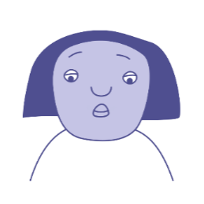

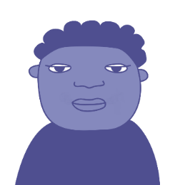

Bullying as a group behaviour
‘Ringleader’
‘Target’
‘Reinforcer’
‘Outsider’
‘Defender’
‘Assistant’
26
Notes:
This learning is key to understanding how to respond to bullying – see page 12 in their pack
Open with an overview of the role of the group in bullying, emphasising bullying as a social phenomenon. Disabled children or those with SEN are made more vulnerable in schools though a lack of facilitated or planned social opportunity and so this learning will help participants understand that dynamic, but it will also empower them to feel more confident about responding in any bullying situation.
This draws on Salmivalli’s participant role scale work. In it she identifies a number of roles that children play in a bullying scenario.
Learning:
That there is always a group in bullying situations
This means that there are some children more (and less) committed to the bullying
Responses should not necessarily focus on the ‘ringleader’ but on a) breaking down the power of the group by acting on ‘assistant ‘and ‘reinforcer ‘roles as well as building support through harnessing the positive power of the ‘defender’ and ‘outsider’ roles
Prevention can also be enhanced with this knowledge because it means that pro-social/social opportunity strategies can be seen in a relevant context
A key point is that this describes a situation rather than a permanent state. The roles can change.
Having broken down the power dynamic, schools can hope to move CYP towards the defender role
Ask which role they think is the most common amongst pupils?
These are the stats from the Salmivalli KIVA summary slide which shows the relative prevalence of roles ( in over 87% of cases that were observed the outsider role was the largest (24%) followed by reinforcers (19.5%
Repeat learning:
That there is always a group in bullying situations
This means that there are some children more (and less) committed to the bullying
Responses should not necessarily focus on the ‘ringleader’ but on a) breaking down the power of the group by acting on ‘assistant ‘and ‘reinforce’ roles as well as building support through harnessing the positive power of the ‘defender’ and ‘outsider’ roles
Prevention can also be enhanced with this knowledge because it means that pro-social/social opportunity strategies can be seen in a relevant context
Explain who they are
These roles are constantly shifting
Most of the roles are determined on not becoming a target
Who is the most stuck in the situation: target / ringleader (is often receiving affirmation from their behaviour and can feel stuck)
So why do we spend so much energy as schools trying to change the behaviour of those most stuck in the situation?
Instead we can start working on changing the behaviour of the people giving the ringleader the power.
http://www.kivaprogram.net/

Slide 15

What is bullying?
Hurtful
Repetitive
Intentional
Power imbalance
28
Notes:
Reinforcement

Slide 16
Bullying and the Law – a quick quiz
1. Bullying is a criminal offence
2. Schools have no responsibility if bullying occurs off school premises
3. Schools have a legal duty to prevent the use of discriminatory language
4. The law relating to bullying does not apply to Academies, Free Schools and Independent schools
Answer
TRUE or FALSE
Notes:
A quick quiz to introduce the bullying in its legal context
Answers:
False Bullying in and of itself is not a criminal offence, however the way in which someone is bullied may be a criminal offence.
False If bullying that took place off school premises is reported to the school, school has the “power” to investigate
True Equalities Act 2010
False Certain elements do apply to Academies, Free Schools and Independent Schools
As an extra question you may wish to ask delegates if they can name all 9 protected characteristics under the Equality Act 2010 (but note they are listed at the end of the Bullying and the Law briefing as part of delegate’s handouts)
The age of criminal responsibility in England and Wales is 10 years old.
This means that children under 10 can’t be arrested or charged with a crime. There are other punishments that can be given to children under 10 – see below
Children over 10
Children between 10 and 17 can be arrested and taken to court if they commit a crime.
They are treated differently from adults and are:
dealt with by youth courts
given different sentences
sent to special secure centres for young people, not adult prisons
Young people aged 18
Young people aged 18 are treated as an adult by the law.
If they’re sent to prison, they’ll be sent to a place that holds 18 to 25-year-olds, not a full adult prison.
Children under 10 who break the law are treated differently to adults or youths under 18 who commit a criminal offence.
Children under 10 cannot be charged with committing a criminal offence. However, they can be given a:
Local Child Curfew
Child Safety Order
Children under 10 who break the law regularly can sometimes be taken into care, or their parents could be held responsible
Local Child Curfew
The police can ban children from being in a public place between 9pm and 6am, unless accompanied by an adult. This is called a Local Child Curfew and can last for up to 90 days.
If a child breaks their curfew, they can be given a Child Safety Order.
Child Safety Order
If a child has committed an offence or broken a Local Child Curfew, they can be placed under the supervision of a youth offending team. This is called a Child Safety Order.
The order normally lasts for up to 3 months, but in some cases it can last for up to 12 months.
If a child doesn’t stick to the rules of an order, the court can consider if the child should be taken into care.

Slide 17
The National Picture of cyberbullying
Notes:
We will take a look at Cyberbullying as a distinct phenomenon as it an area of concern to many schools and has its own particular challenges

Slide 18
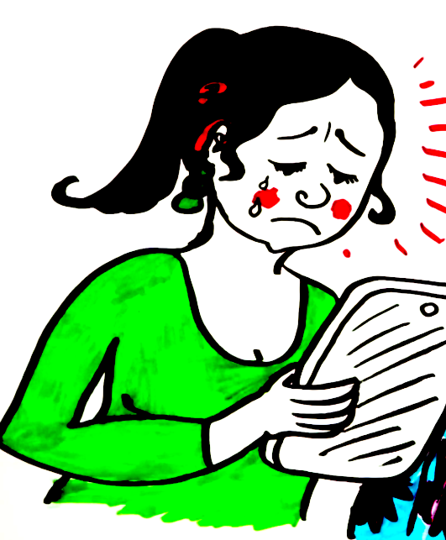
Cyberbullying is any form of bullying that is carried out through the use of electronic media devices, such as computers, laptops, smartphones, tablets, or gaming consoles
What is cyberbullying?

Slide 19
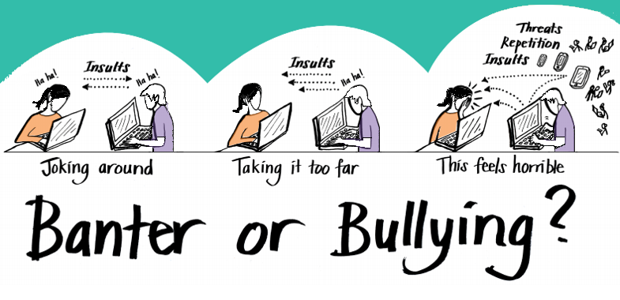
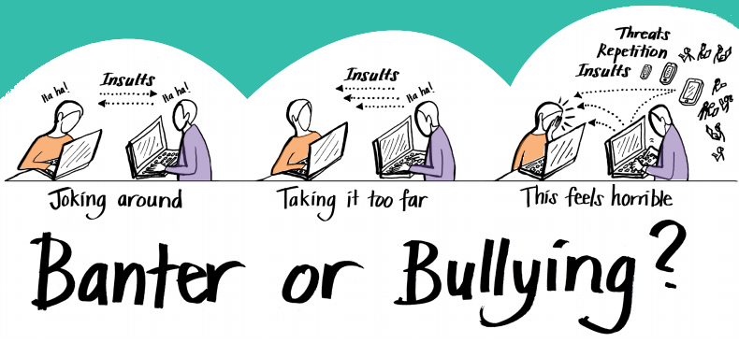
Notes:
Chance to briefly discus the difference between bullying and banter.
Please remind that we provide links to tools about banter on the All Together platform.

Slide 20
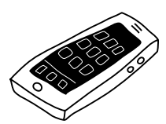

Prevalence
Data is very varied
24% of children and young people will experience some form of cyberbullying
Same study said 17% will of CYP will cyberbully others
Name calling the most common type of cyberbullying
Notes:
A review of 35 international studies on cyberbullying concluded that around 24% of children and young people will experience some form of cyberbullying.
These include:
• Written or verbal attacks
• Threats of physical violence (including towards a person’s family
or property)
• Name calling
• Denigration (putting some down in front of others)
• Cyberstalking (following someone without their knowledge)
• Masquerading (pretending to be someone different or setting up
fake profiles)
• Exclusion
• Prank or silent phone calls
• Outing (posting personal information without consent)
• Impersonation (stealing someone’s password and pretending
to be them)
• Flaming (intentionally starting fights)
• Rumour spreading

Slide 21

Communication
Some forms of comms are used to cyberbully more than others
the most common ways of being cyberbullied were through phone calls, text messages and instant messaging
A survey found:
over 40% of participants had been bullied
through instant messaging
1 in 10 through online games, or social
networking sites

Slide 22

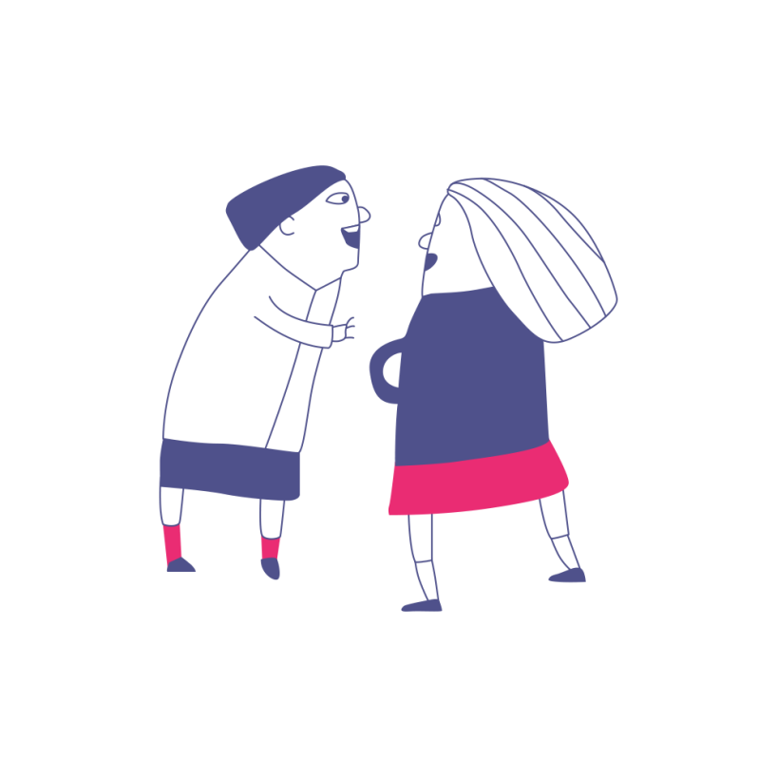
The relationship between cyberbullying and ‘traditional’ bullying
Notes:
Where do you think bullying starts? Online or face to face?

Slide 23
Cyberbullying vs. Traditional Bullying
A study of 1,211 adolescents found:
A different study found:
23% experienced both forms of bullying (as victim or perpetrator)
Only 7% exclusively involved in cyberbullying
80% cyberbullying victims were also victims of traditional bullying
90% of children who cyberbullied others also perpetrated traditional bullying
Only 10% children involved in cyberbullying have not experienced traditional bullying
Notes:
A review of 35 international studies on cyberbullying concluded that around 23% of children and young people will experience some form of cyberbullying.
However, it is notable that there is a very significant overlap between cyberbullying and traditional bullying. Only in circa 10% of cases is bullying only happening online. In the vast majority of cases it has begun offline. Some studies show that this overlap is decreasing, however.

Slide 24

Legal context – True or False?
It is the responsibility of parents – not schools – to intervene to sort out cyberbullying
False
Notes:
Law is outlined in their pack briefing ‘bullying and the law’ – it’s also important to note to the group the PSED duties. There is also a unit on the Law in the ABA online training
Participants needs to understand the contexts in which bullying is understood and (specifically), the context for schools both in terms of legislation but also practice.
Following presentation of the key legal drivers, this session then can be a dialogue between the facilitator and participants to draw out the practice contexts for the work that they are involved in if there is time.
From this, there will emerge a clear link into the next section which sets out the distinction between medical model thinking and social model thinking, and which proposes that social model thinking is the way to make this issue one of proactive and positive change rather than reactive responses to individual issues.

Slide 25
Cyberbullying and SEN/Disability
Disabled children and those with SEN are more likely to:
  Not be online
  Experience cyberbullying
Not taught about internet safety
and cyberbullying as much as others.
Discouraged from using the internet
See disablist language online

Slide 26
What are the key issues for young people?
Notes:
We will take a look at Cyberbullying as a distinct phenomenon as it an area of concern to many schools and has its own particular challenges

Slide 27

Cyberbullying
What makes it different?
24-7 nature
Potential wider audience & long lasting impact
Isolation
Evidence
Potential to hide your identity
Degree of separation
Notes:
Ask delegates to shout out what makes it different to traditional bullying. They are likely to mention many of the points that will then come in on a click.
By degree of separation we mean that when you are behind a phone or devise you can’t see the impact of what you say. So there is a certain amount of separation from the impact of the bullying.
Experiences of cyberbullying include
• Written or verbal attacks
• Threats of physical violence (including towards a person’s family or property)
• Name calling
• Denigration (putting some down in front of others)
• Cyberstalking (following someone without their knowledge)
• Masquerading (pretending to be someone different or setting up fake profiles)
• Exclusion
• Prank or silent phone calls
• Outing (posting personal information without consent)
• Impersonation (stealing someone’s password and pretending to be them)
• Flaming (intentionally starting fights)
• Rumour spreading

Slide 28
What works?
Notes:
We will take a look at Cyberbullying as a distinct phenomenon as it an area of concern to many schools and has its own particular challenges

Slide 29
Cyberbullying
Cyberbullying statistics
Positive family communication, especially with a father, are less likely to experience cyberbullying
Positive perceptions of the school environment are associated with lower levels of cyberbullying
Cyberbullying associated with feelings of safety in young people’s local neighbourhood
Cyberbullying
Influences
Notes:
An analysis of data from the Health Behaviour in School-aged Children (HBSC) survey for England, 2014. The data draws on responses from 5,335 students aged 11-15 years who completed the HBSC survey in England.

Slide 30

What can schools do?
Use a whole-school approach
Specifically refer to cyberbullying
in your policies
Be clear of the school’s position
Make sure the school community
understand what cyberbullying is
Make sure young people know
how to report online
Notes:
N.B. We will discuss a whole-school approach later in the day.

Slide 31

Preventing Cyberbullying
Encourage children to think before
they post and be ‘upstanders’ online
Promote the positive aspects of
technology
Cover online safety through the
curriculum
Provide information about cyberbullying in a
variety of formats throughout school
Ask young people about their experiences!

Slide 32
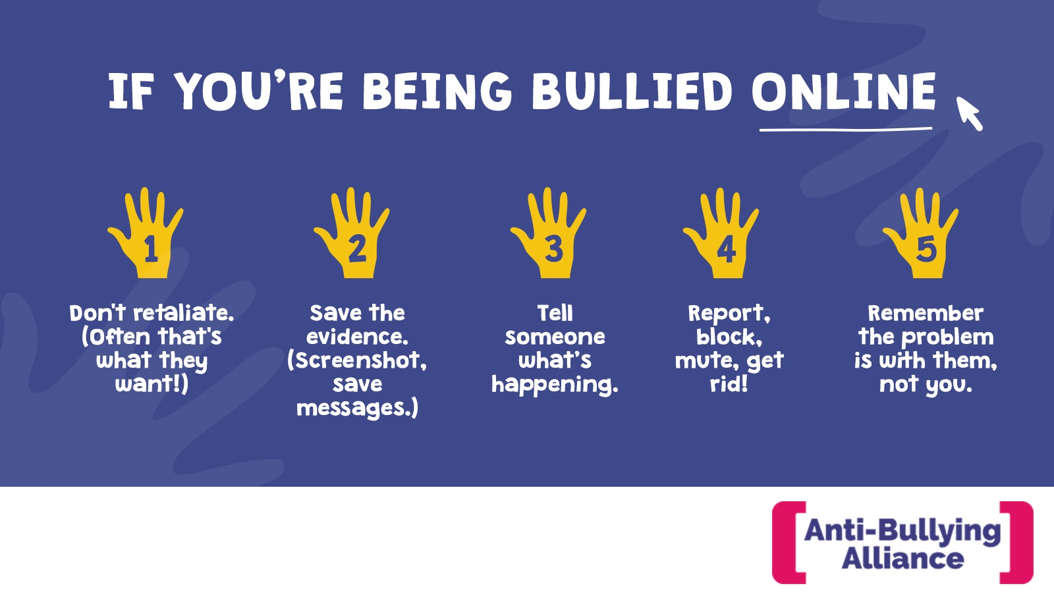
Notes:
To encourage children and young people to report incidents
of cyberbullying, reporting procedures should be clearly
outlined, and understood by all member of the school
community. Those who experience cyberbullying should
know exactly how and to whom it should be reported.
• Anyone who reports cyberbullying should be provided with
the necessary support, and reassured that reporting the
bullying was the right course of action. Victims should be
referred to the appropriate person for pastoral support, and
procedures put in place to avoid further incidents. Staff
should encourage students to take an active role in this
process, so that they feel they are in control of the situation.
• Depending on the nature of the incident, offer students
advice as to what their next steps should be. This could range
from saving evidence, through to showing the student how
to block someone, or change their privacy settings. The most
important advice is to prevent the child from retaliating, as
this will likely enflame the situation.
• Where possible, take steps to contain the incident or advise
the student how they can do this. This could include
contacting the offender directly, or contacting the
appropriate service provider. Many websites or social
networking sites will have a dedicated support service which
can be used to report incidents of bullying or abuse. If the
cyberbullying violates laws then the police should be
contacted.
• Investigate incidents fully, and keep a record of all actions.
Many incidents of cyberbullying are carried out by someone
known to the victim, so it may be possible to identify the
offender, and if they are a student within the school, take the
appropriate disciplinary steps.
• Work with those who are responsible for the bullying
behaviour. Perpetrators of cyberbullying are also at risk of
poorer health outcomes, and may have been victims of
bullying themselves. Advising them on how to use
technology safely and responsibly, as well as encouraging
them to think about how their actions affect others, may help
to dissuade them from engaging in further bullying.

Slide 33
What is available for schools?
Anti-Bullying Alliance
cyberbullying information and tools
free CPD Online training (including a module on cyberbullying)
Childnet International
cyberbullying guidance for schools
resources for teachers and professionals
UK Safer Internet Centre
where you can find e-safety tips, advice and resources to help children and young people stay safe online
Professionals Online Safety Helpline (POSH)

Slide 34
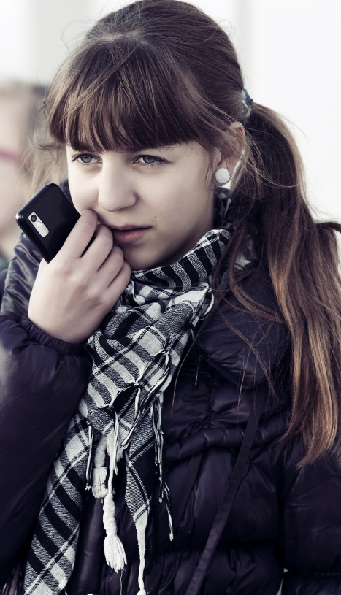
What is available for schools?
Think U Know - supporting schools to deliver education and raise awareness of online child exploitation and abuse
Diana Award (Anti-Bullying Pro) resources
NSPCC bullying and cyberbullying resources
South West Grid for Learning
UK Council for Child Internet Safety (UKCCIS)
Department for Education – preventing bullying guidance

Slide 35

All Together Programme

Slide 36
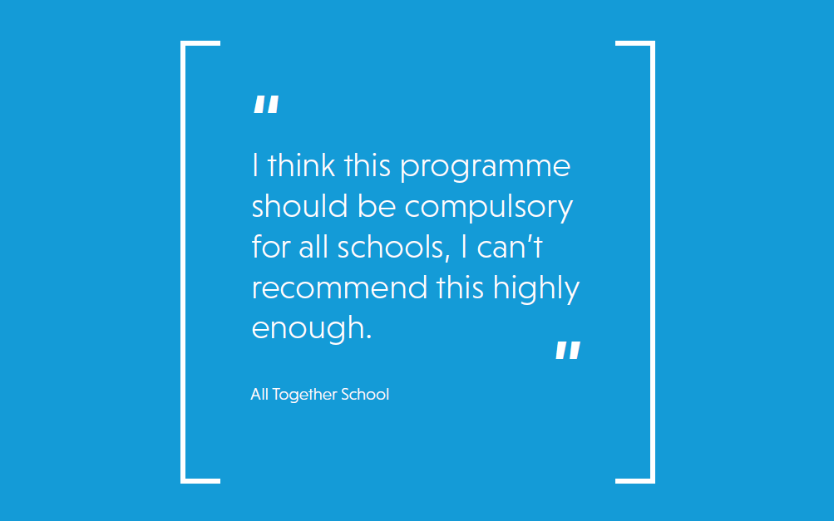

Slide 37
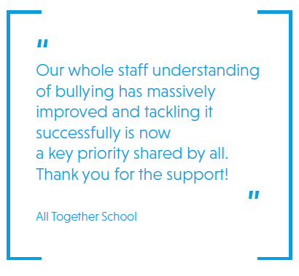
Participating schools have access to:
A responsive audit and action planning tool
Resources to support implementation of their action plan
Online CPD training for all staff
An online pupil wellbeing questionnaire
Some local areas had access to face to face training

Slide 38
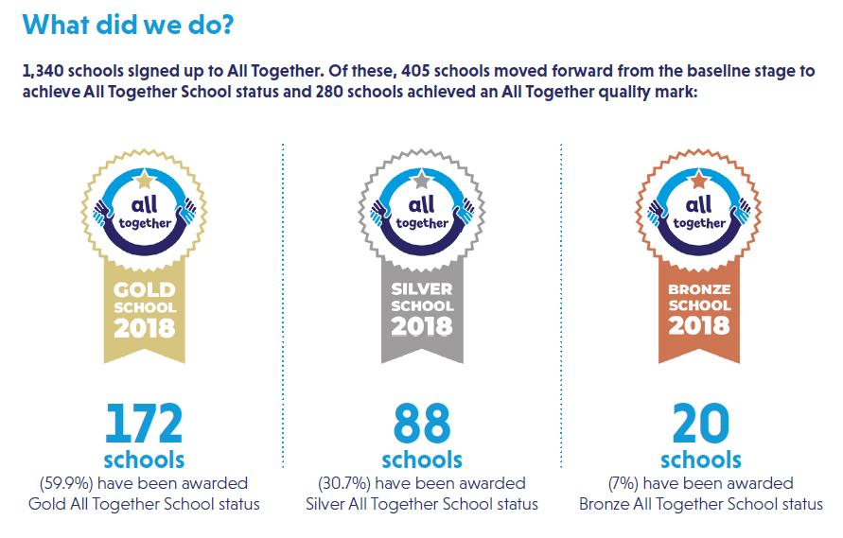

Slide 39
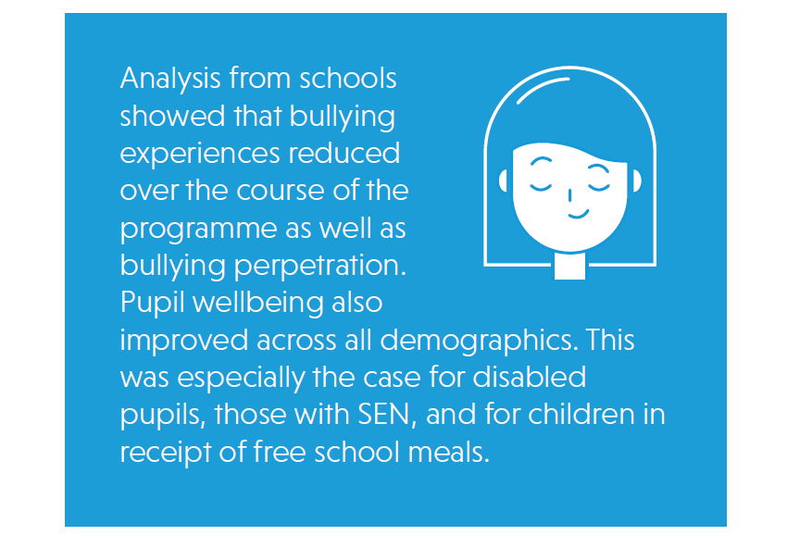

Slide 40
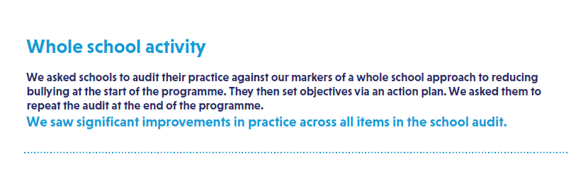
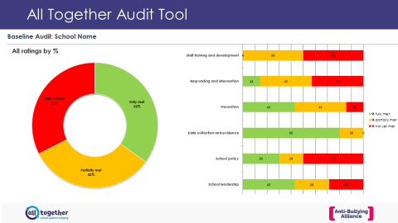

Slide 41


Slide 42
Thank you for participating. www.anti-bullyingalliance.org.uk

